Slide 1
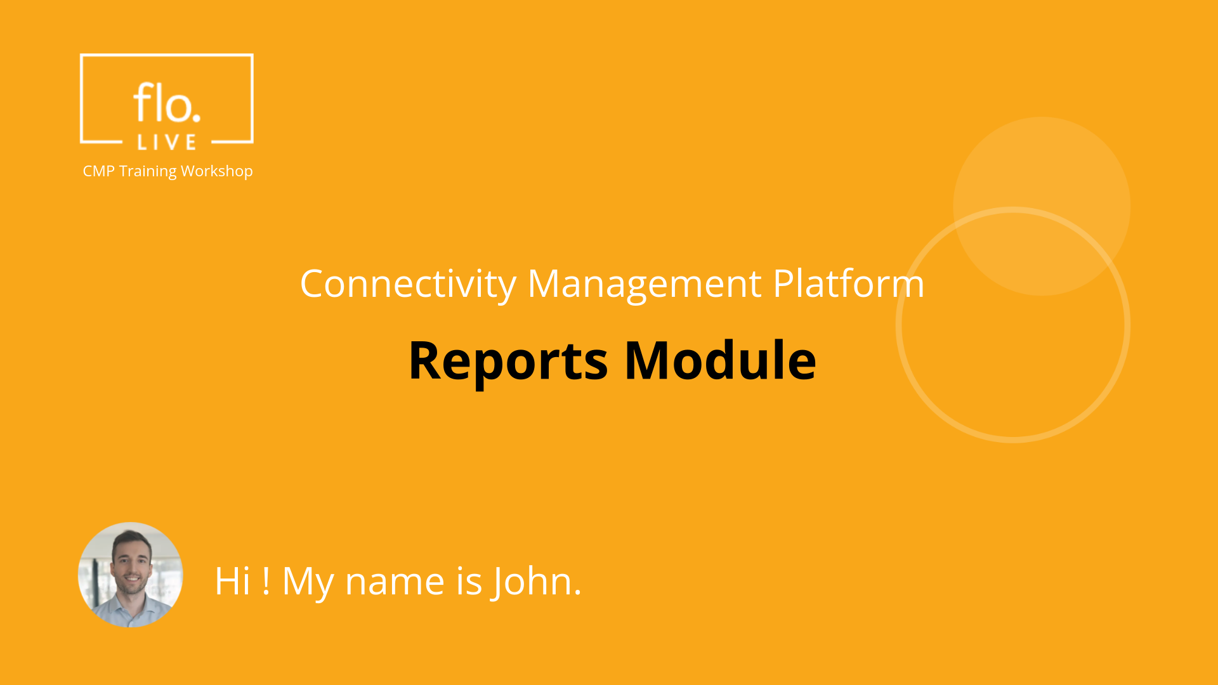
Notes:
Hi. My name is John and welcome to the CMP Training Workshop

Slide 2
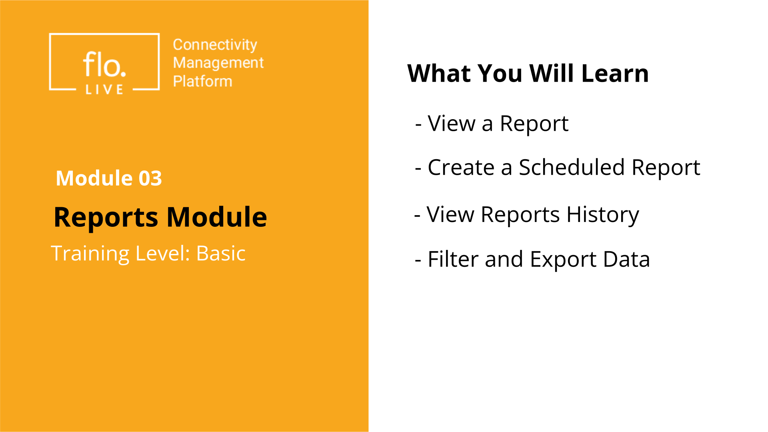
Notes:
In this tutorial, we will explore the Reports module. You will learn how to view reports stored in the system, generate a a new automated Scheduled Report, view the report history table, and filter the report table to export data to an external file.

Slide 3
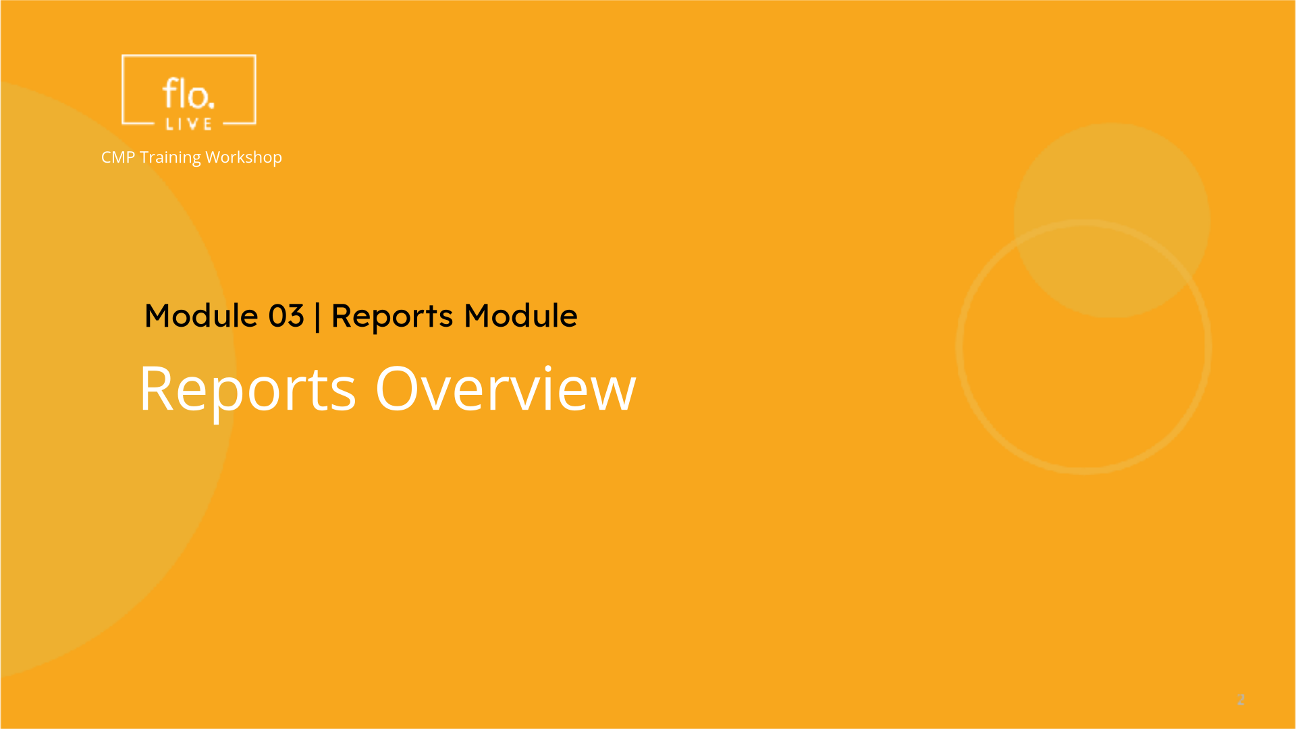
Notes:
We begin this tutorial with a quick tour of the Reports module.

Slide 4
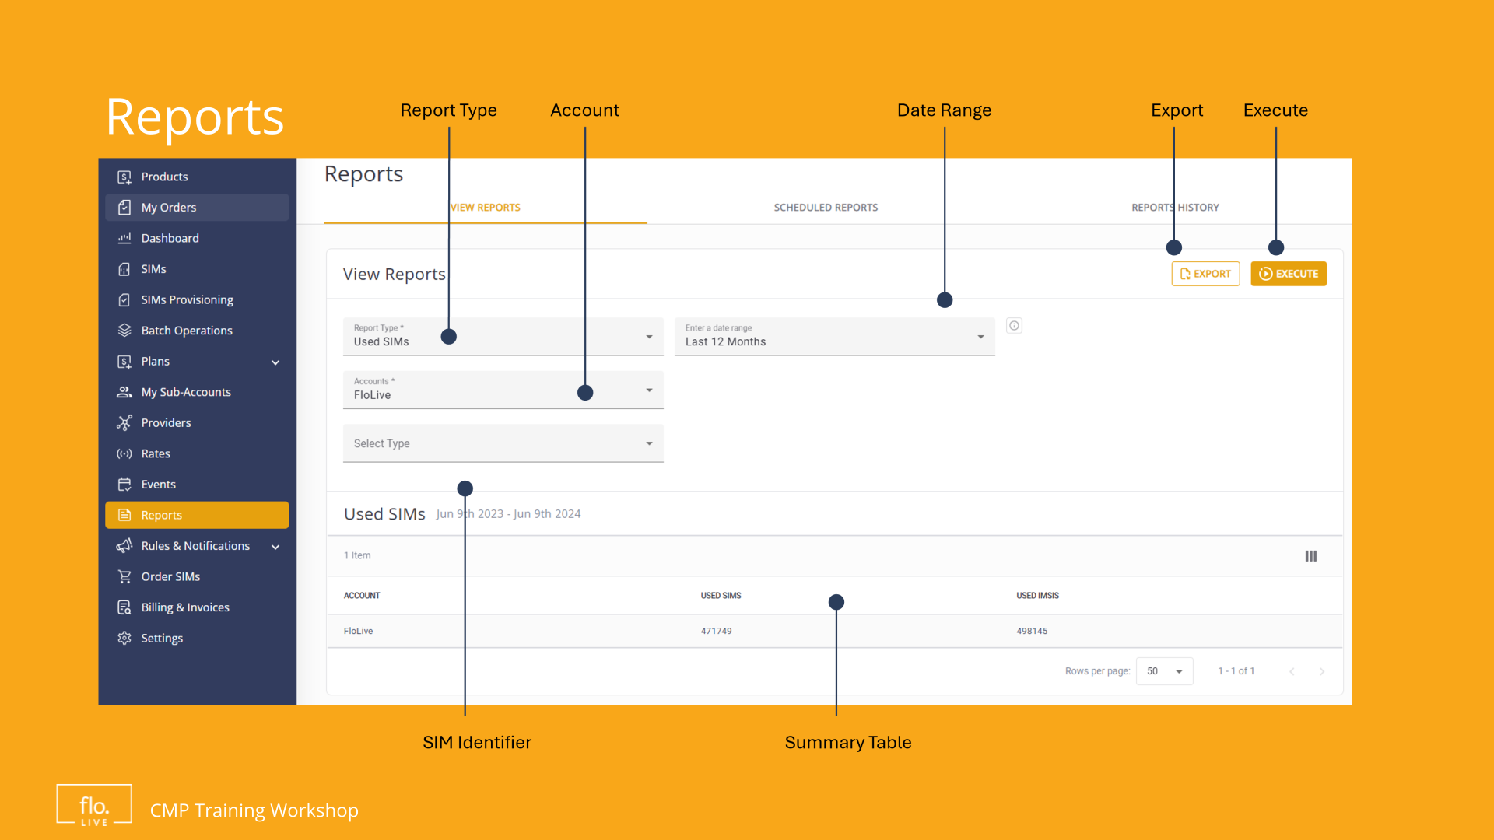
Notes:
The View Reports tab is displayed as the default when you access the Reports module. Here you can generate a wide range of reports based on various parameters and selection criteria.

Slide 5
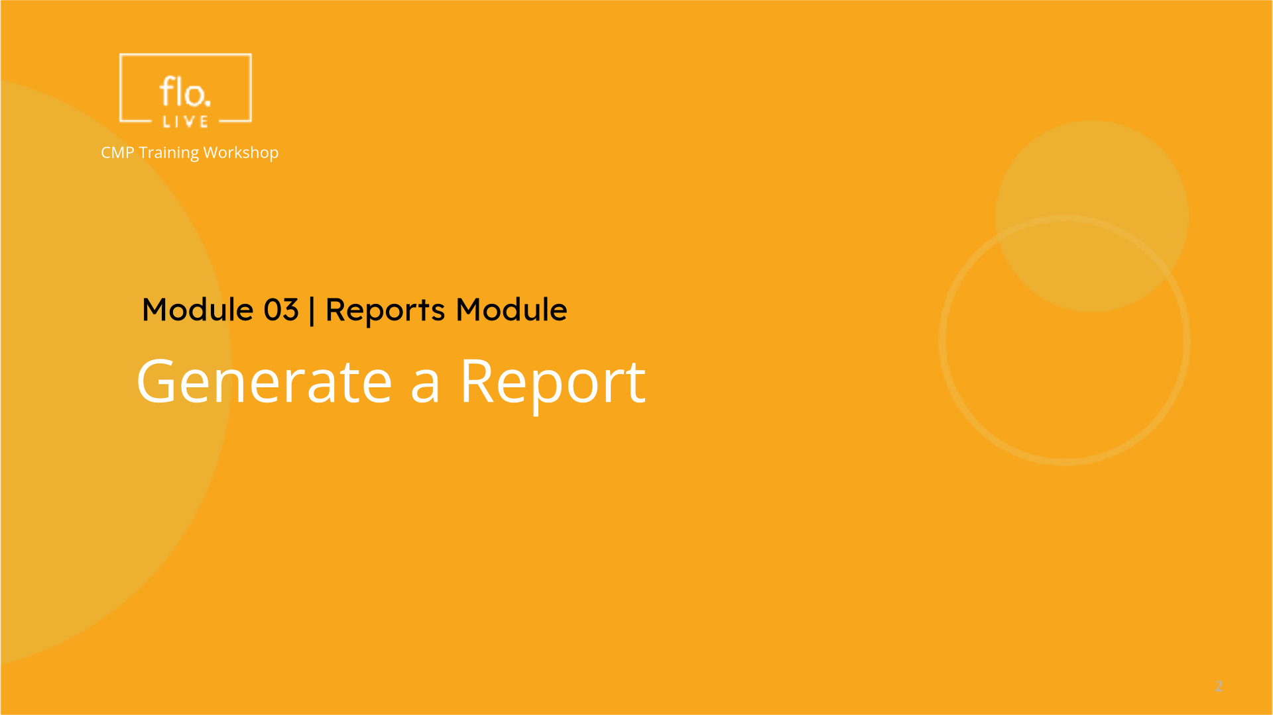
Notes:
Lets learn how to generate a report.

Slide 6
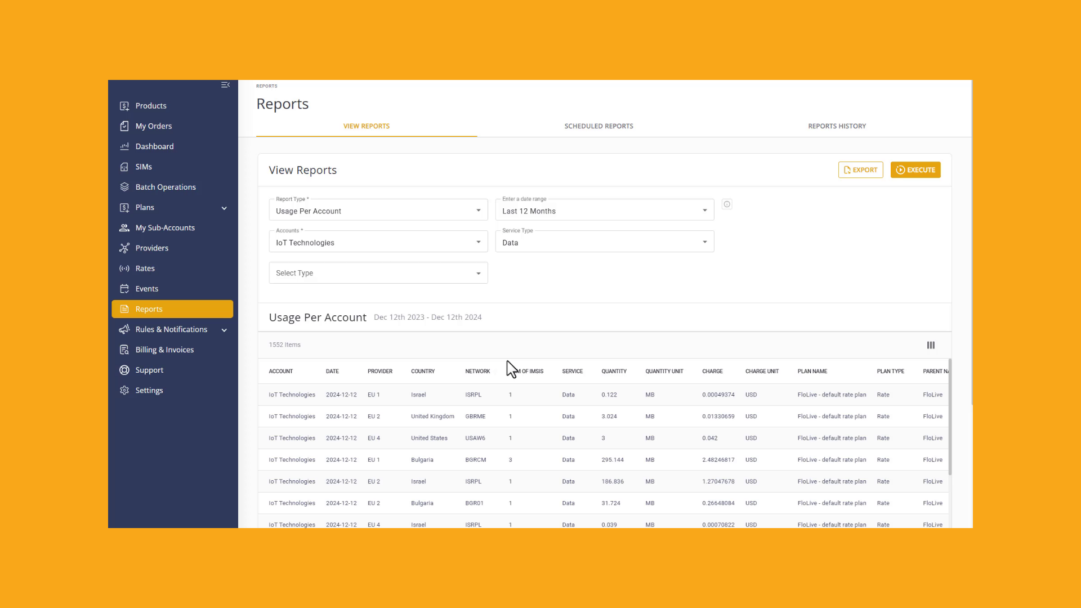
Notes:
Navigate to the sidebar and click the Reports menu item. The Reports module has three tabs. The first tab is the View Reports tab. The Scheduled Report and Reports history tabs are discussed later in this tutorial. Lets see how to select and View a report. Go to the Report Type field to select a report. The report name and table data is displayed at the bottom of the screen. . You can scroll the table to view the report data. . To select a different report, go to the Report type field and select a report from the list. Select one or more accounts and the SIM Identifer type. Finally select the relevant timeframe from the list. or you can specify a custom timeframe by selecting the start date and end date. To generate the report click the Execute button. You can now view the data for the selected report.

Slide 7
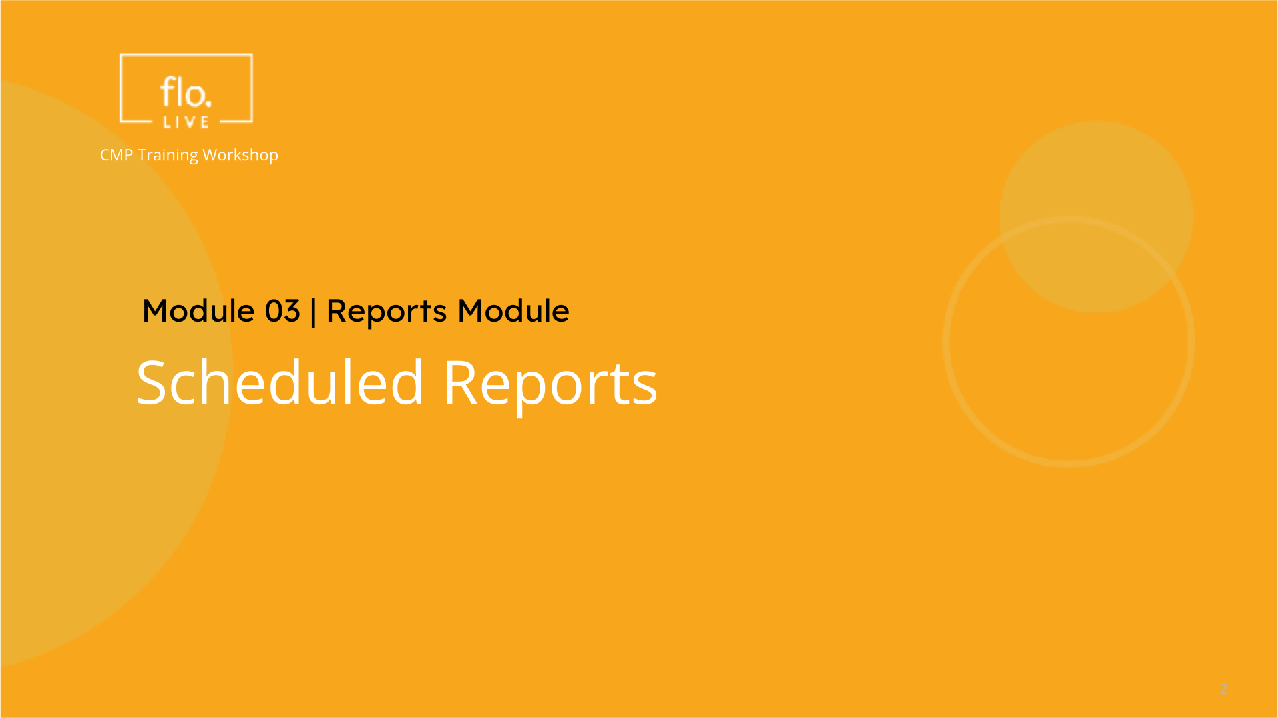
Notes:
Now that you know how to use the Reports module, we can create a Scheduled report to run automatically for a specified period of time.

Slide 8
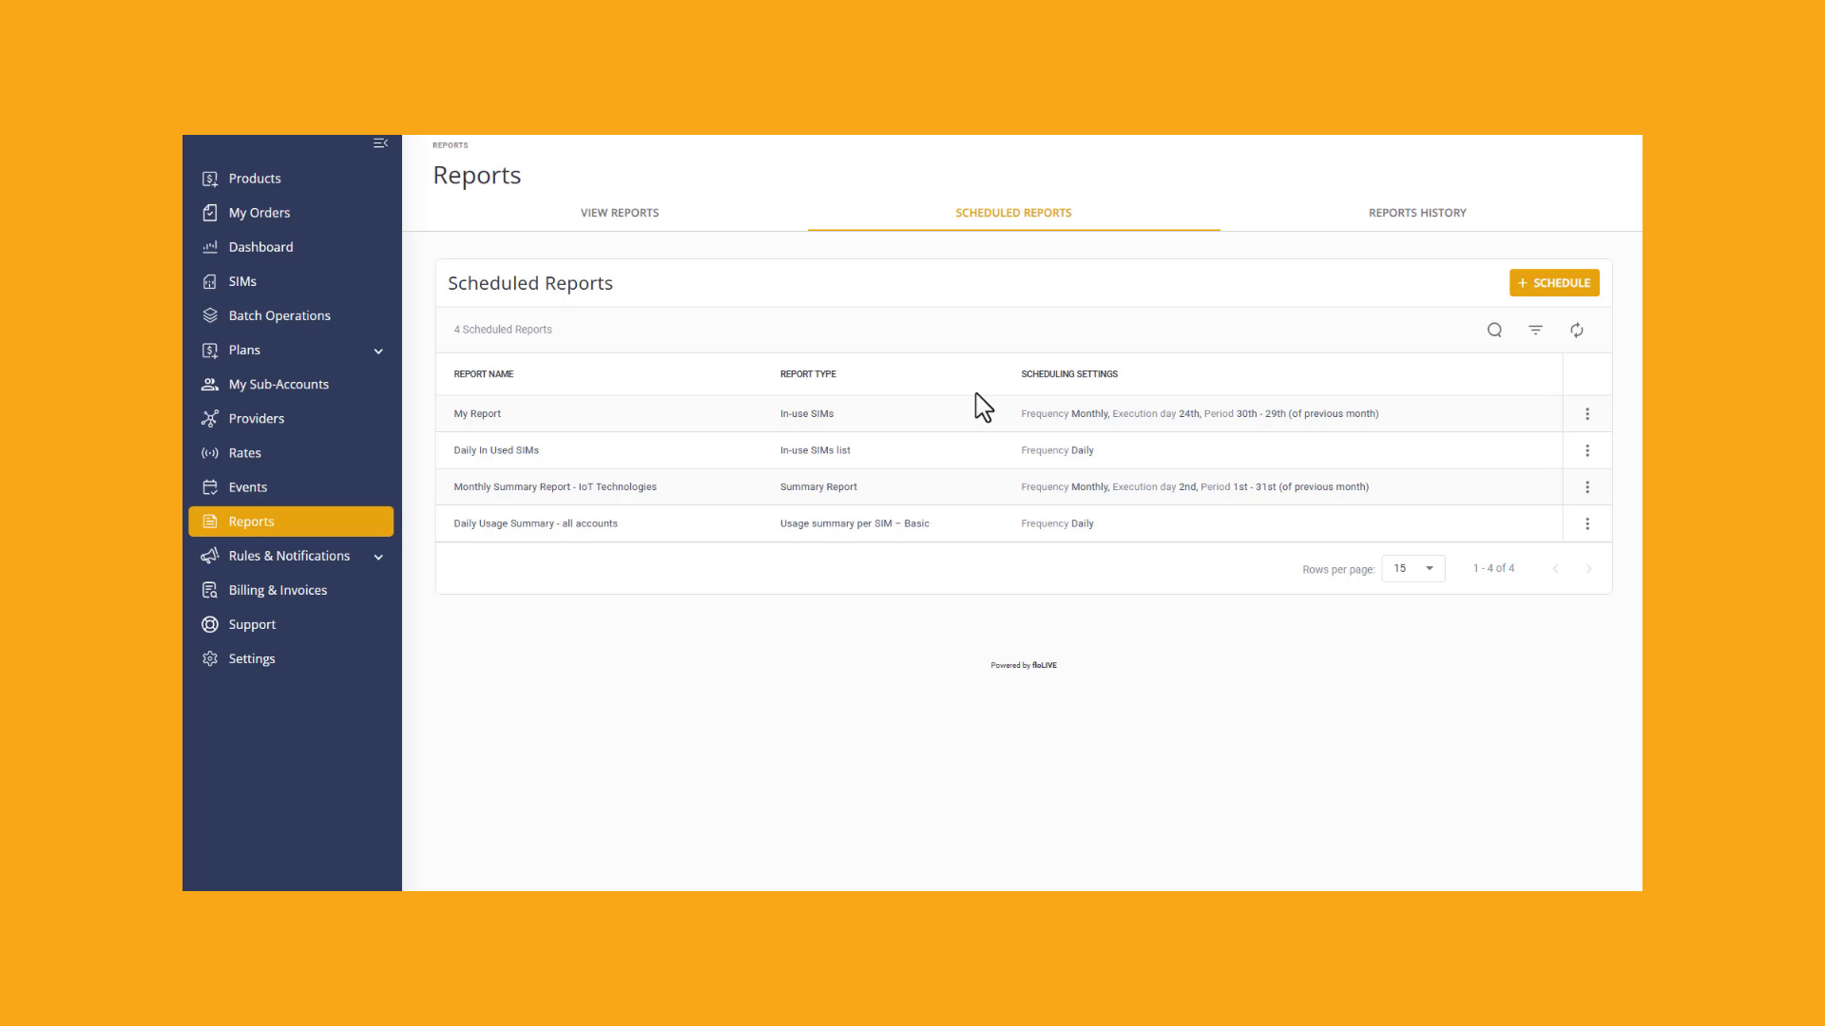
Notes:
On the reports page, select the Scheduled Reports tab. A list of existing Scheduled Reports is displayed in the reports table. To generate a new Scheduled Report, click the Add Schedule button. Now enter the name of your report. . Then select the type of report you want to generate. Each type of report consists of various parameters that enable you to specify the type of data you want to include in your report. You will notice that these fields may vary depending on the type of report you select and the type of data you want to include. . When you create a new report it is important that you select the Schedule Settings. You can generate a daily, weekly or monthly report by selecting the Frequency and execution dates. Click the Create button to update the Scheduled Reports table

Slide 9
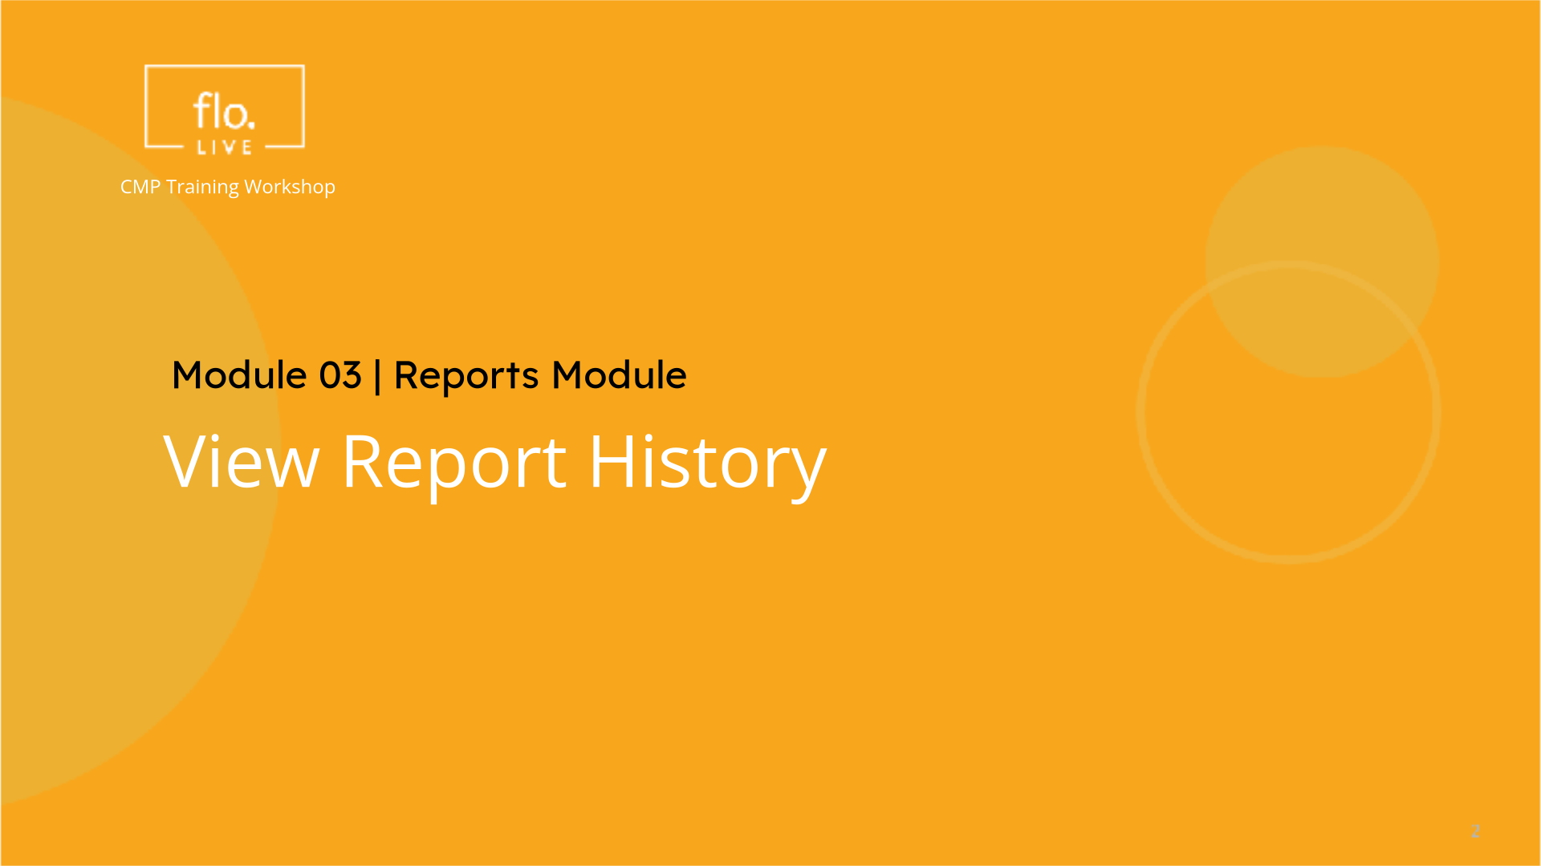
Notes:
To complete this tutorial we will examine the reports history tab.

Slide 10

Notes:
The Reports History module serves as a central archive for all reports generated by the system. Each report is displayed in a seperate row in the Reports History Table. You can filter the Reports History table by selecting the Creation Date, The Type of Report you want to display, and an option to select the Success, Failed or In-Progress report status. Click Apply to update the report history table. Finally, you can select one of the report actions to export data to an external file or to delete the report data from report history table.

Slide 11
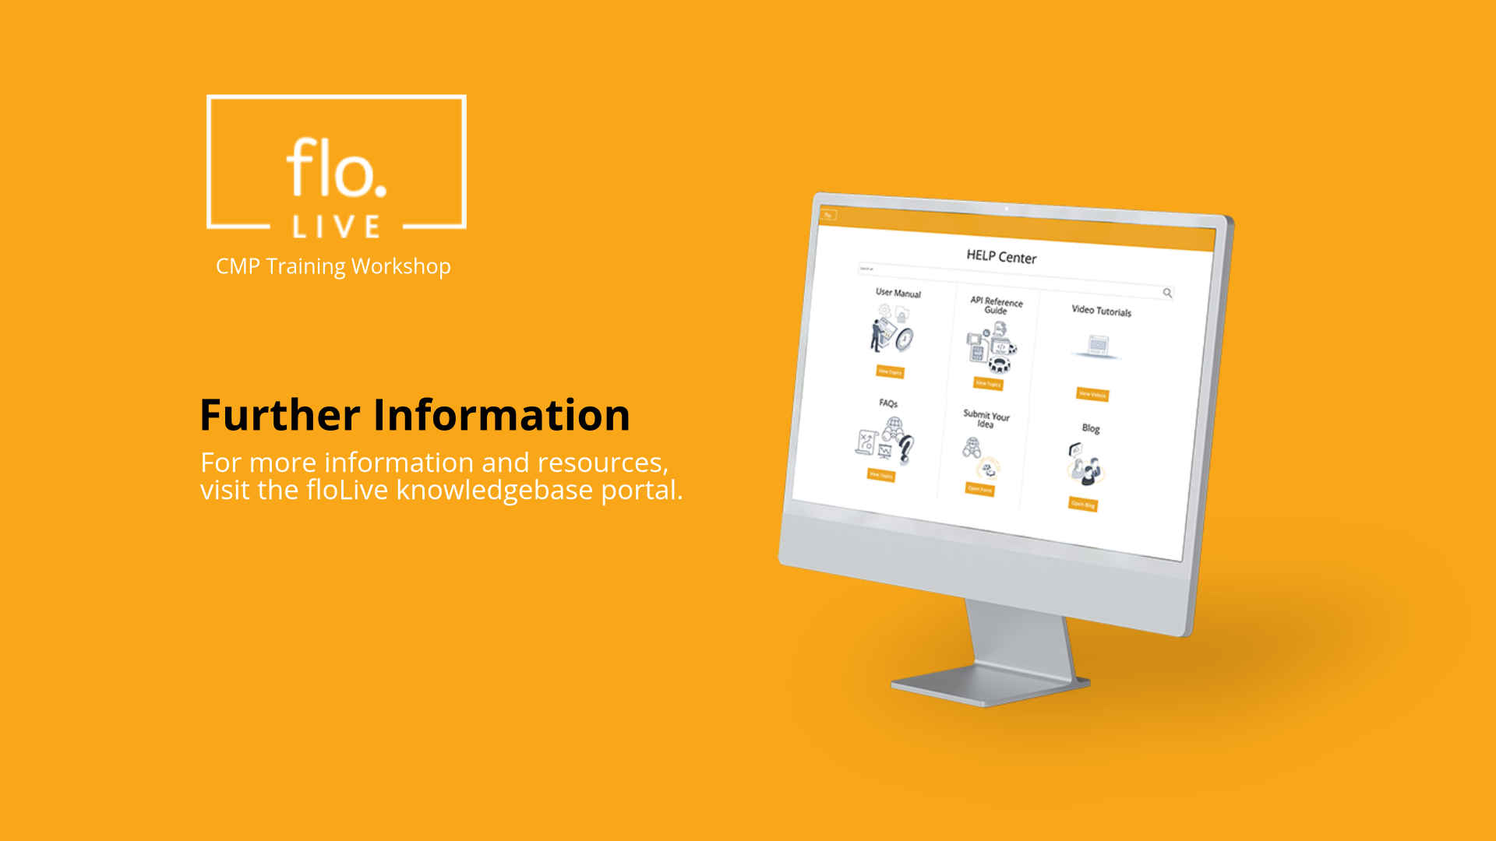
Notes:
Thank you for watching this video tutorial. For more information about the CMP system, make sure you visit our Knowledge-base that is accessible directly from the CMP Portal.

